Slide 1



A Finnish & Belgian collaboration
Notes:
Mathias
We developed the Piago.
Piano on the go.
It is a portable device that is rolable?(wat is oprollen in het engels) and easy to use

Slide 2
Flow
Hardware
Debug - Test Device
MIDI explanation
Software - Android application
Software - Desktop application
Reflection
Live demos/videos + Q&A
Notes:
Mathias
First our finish colleague's are going to present physical device.
Debug-test device from the belgian side
Up next we are going to explain what midi files are and how they work.
Then we will explain the workings of the two applications that we developed.
Starting whit the Android version followed by the C# one.
Second to last we will try to show a live demo and to finish it of we will reflect on the two months we where working together.

Slide 3
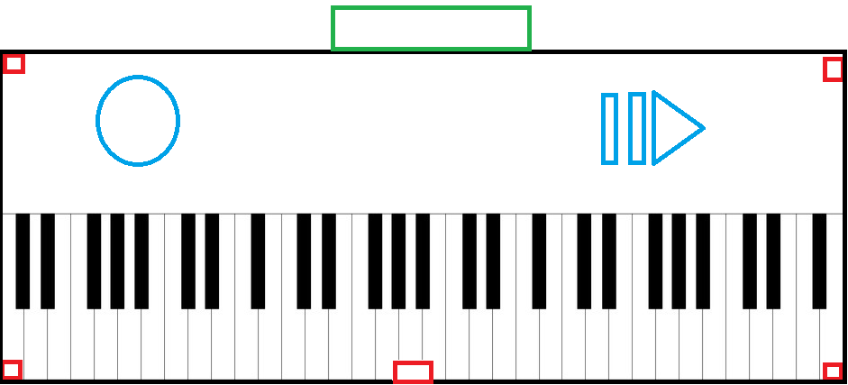
The Device
Piano layout printed on a mat
Computing unit with device stand
ESP32 Wrover
Sensors
Leds on each key
Notes:
Teemu
Recap of the original device plans.
Piano layout on a rollable mat or surface
Computing unit (green box). Powerful enough with built in bluetooth and wifi capabilities.
Piezo sensor locations (red box)
Leds on each keys (not shown)

Slide 4
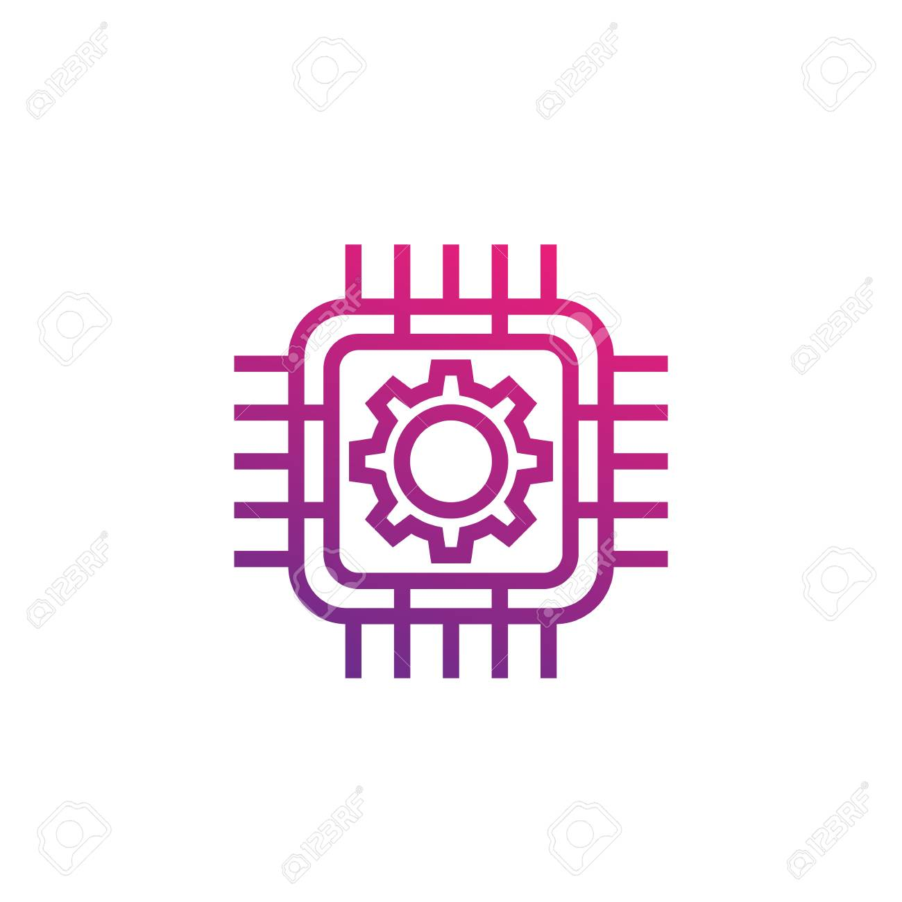
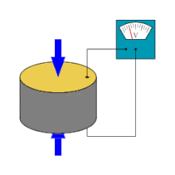
Hardware - The original idea
Piezo- sensor
Challenging
Time consuming
Expensive logic IC (PECL vs TTL)
Notes:
Teemu
A piezoelectric disk generates a voltage when deformed (change in shape is greatly exaggerated)
In our case sound waves deform the sensor.
Glass table: vibration speed 4km/s, 3cm key width -> 7 us max delay in calculations
PECL - Positive Emitter Coupled Logic
TTL - Transistor to Transistor Logic

Slide 5
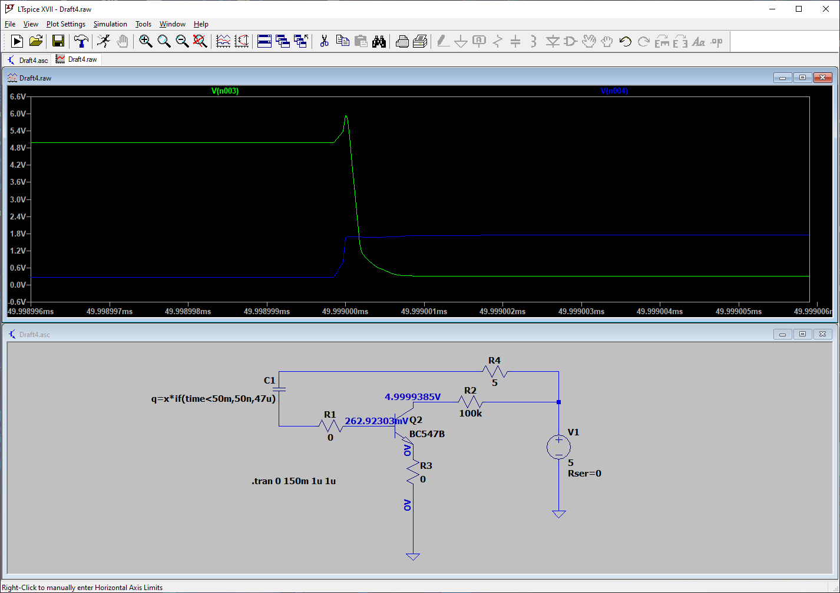
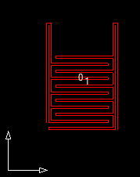
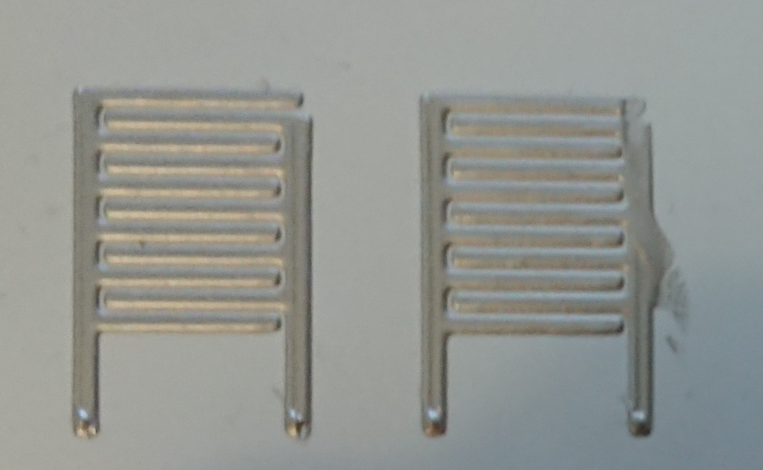
Hardware - The Backup
Capacitive sensing
Can use similar logic ICs
More sensors -> bigger registers
Less time constraint -> cheaper & more logic control in MCU
Notes:
JARI
Using 74165 8-bit shiftregister for parallel -> serial

Slide 6
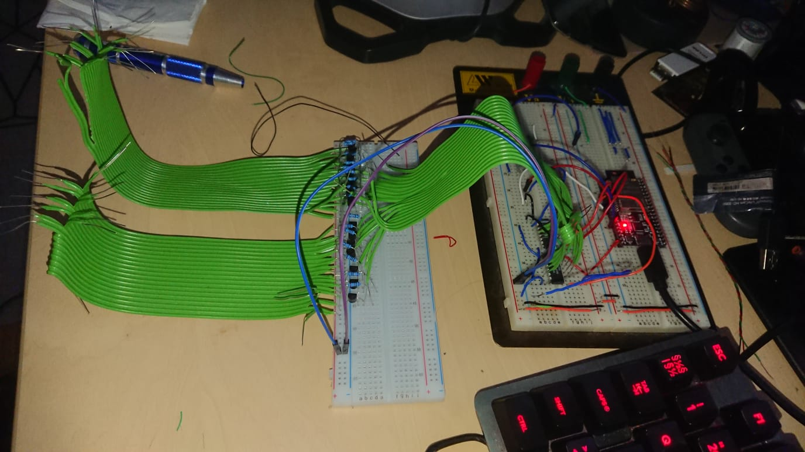
Hardware - The Backup of Backup
Printed sensors were not suitable
Printed capacitor capacity too low
Connection not stable
Piezos too expensive and time consuming
Use wires as a resistive sensor
Notes:
JARI
Monster piano demo: https://www.youtube.com/watch?v=wp72fV8pQTY

Slide 7
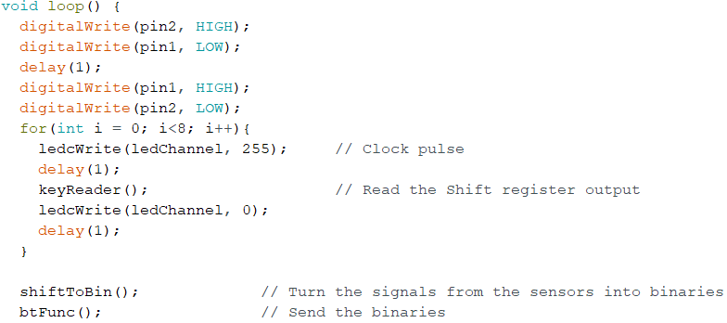
Hardware - The Code
Main functions:
Read shift register outputs
Convert shift register output to binary values
Send binary values via Bluetooth
Control the shift register clock
Notes:
Speaker: Janne

Slide 8
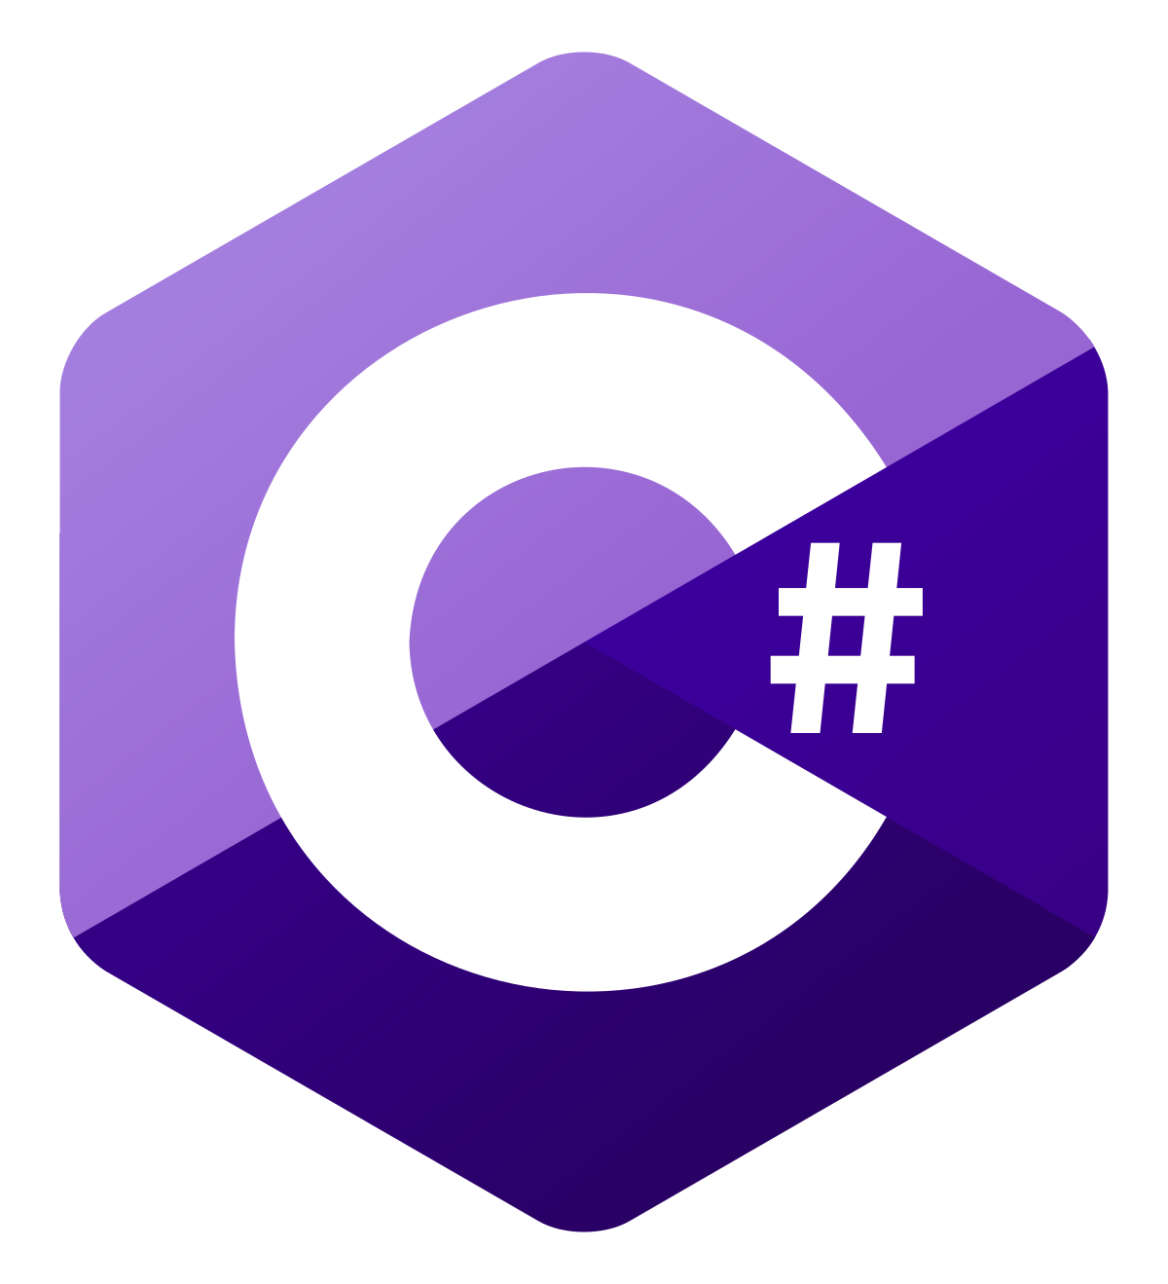
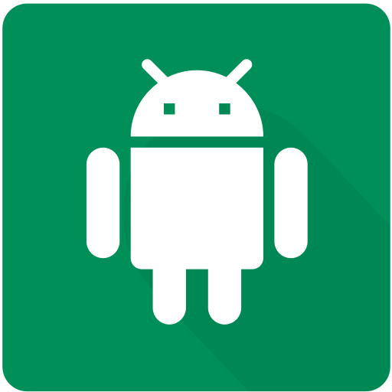
General Used Technologies
Technologies used in both Android and Desktop application
Notes:
Arnaud

Slide 9
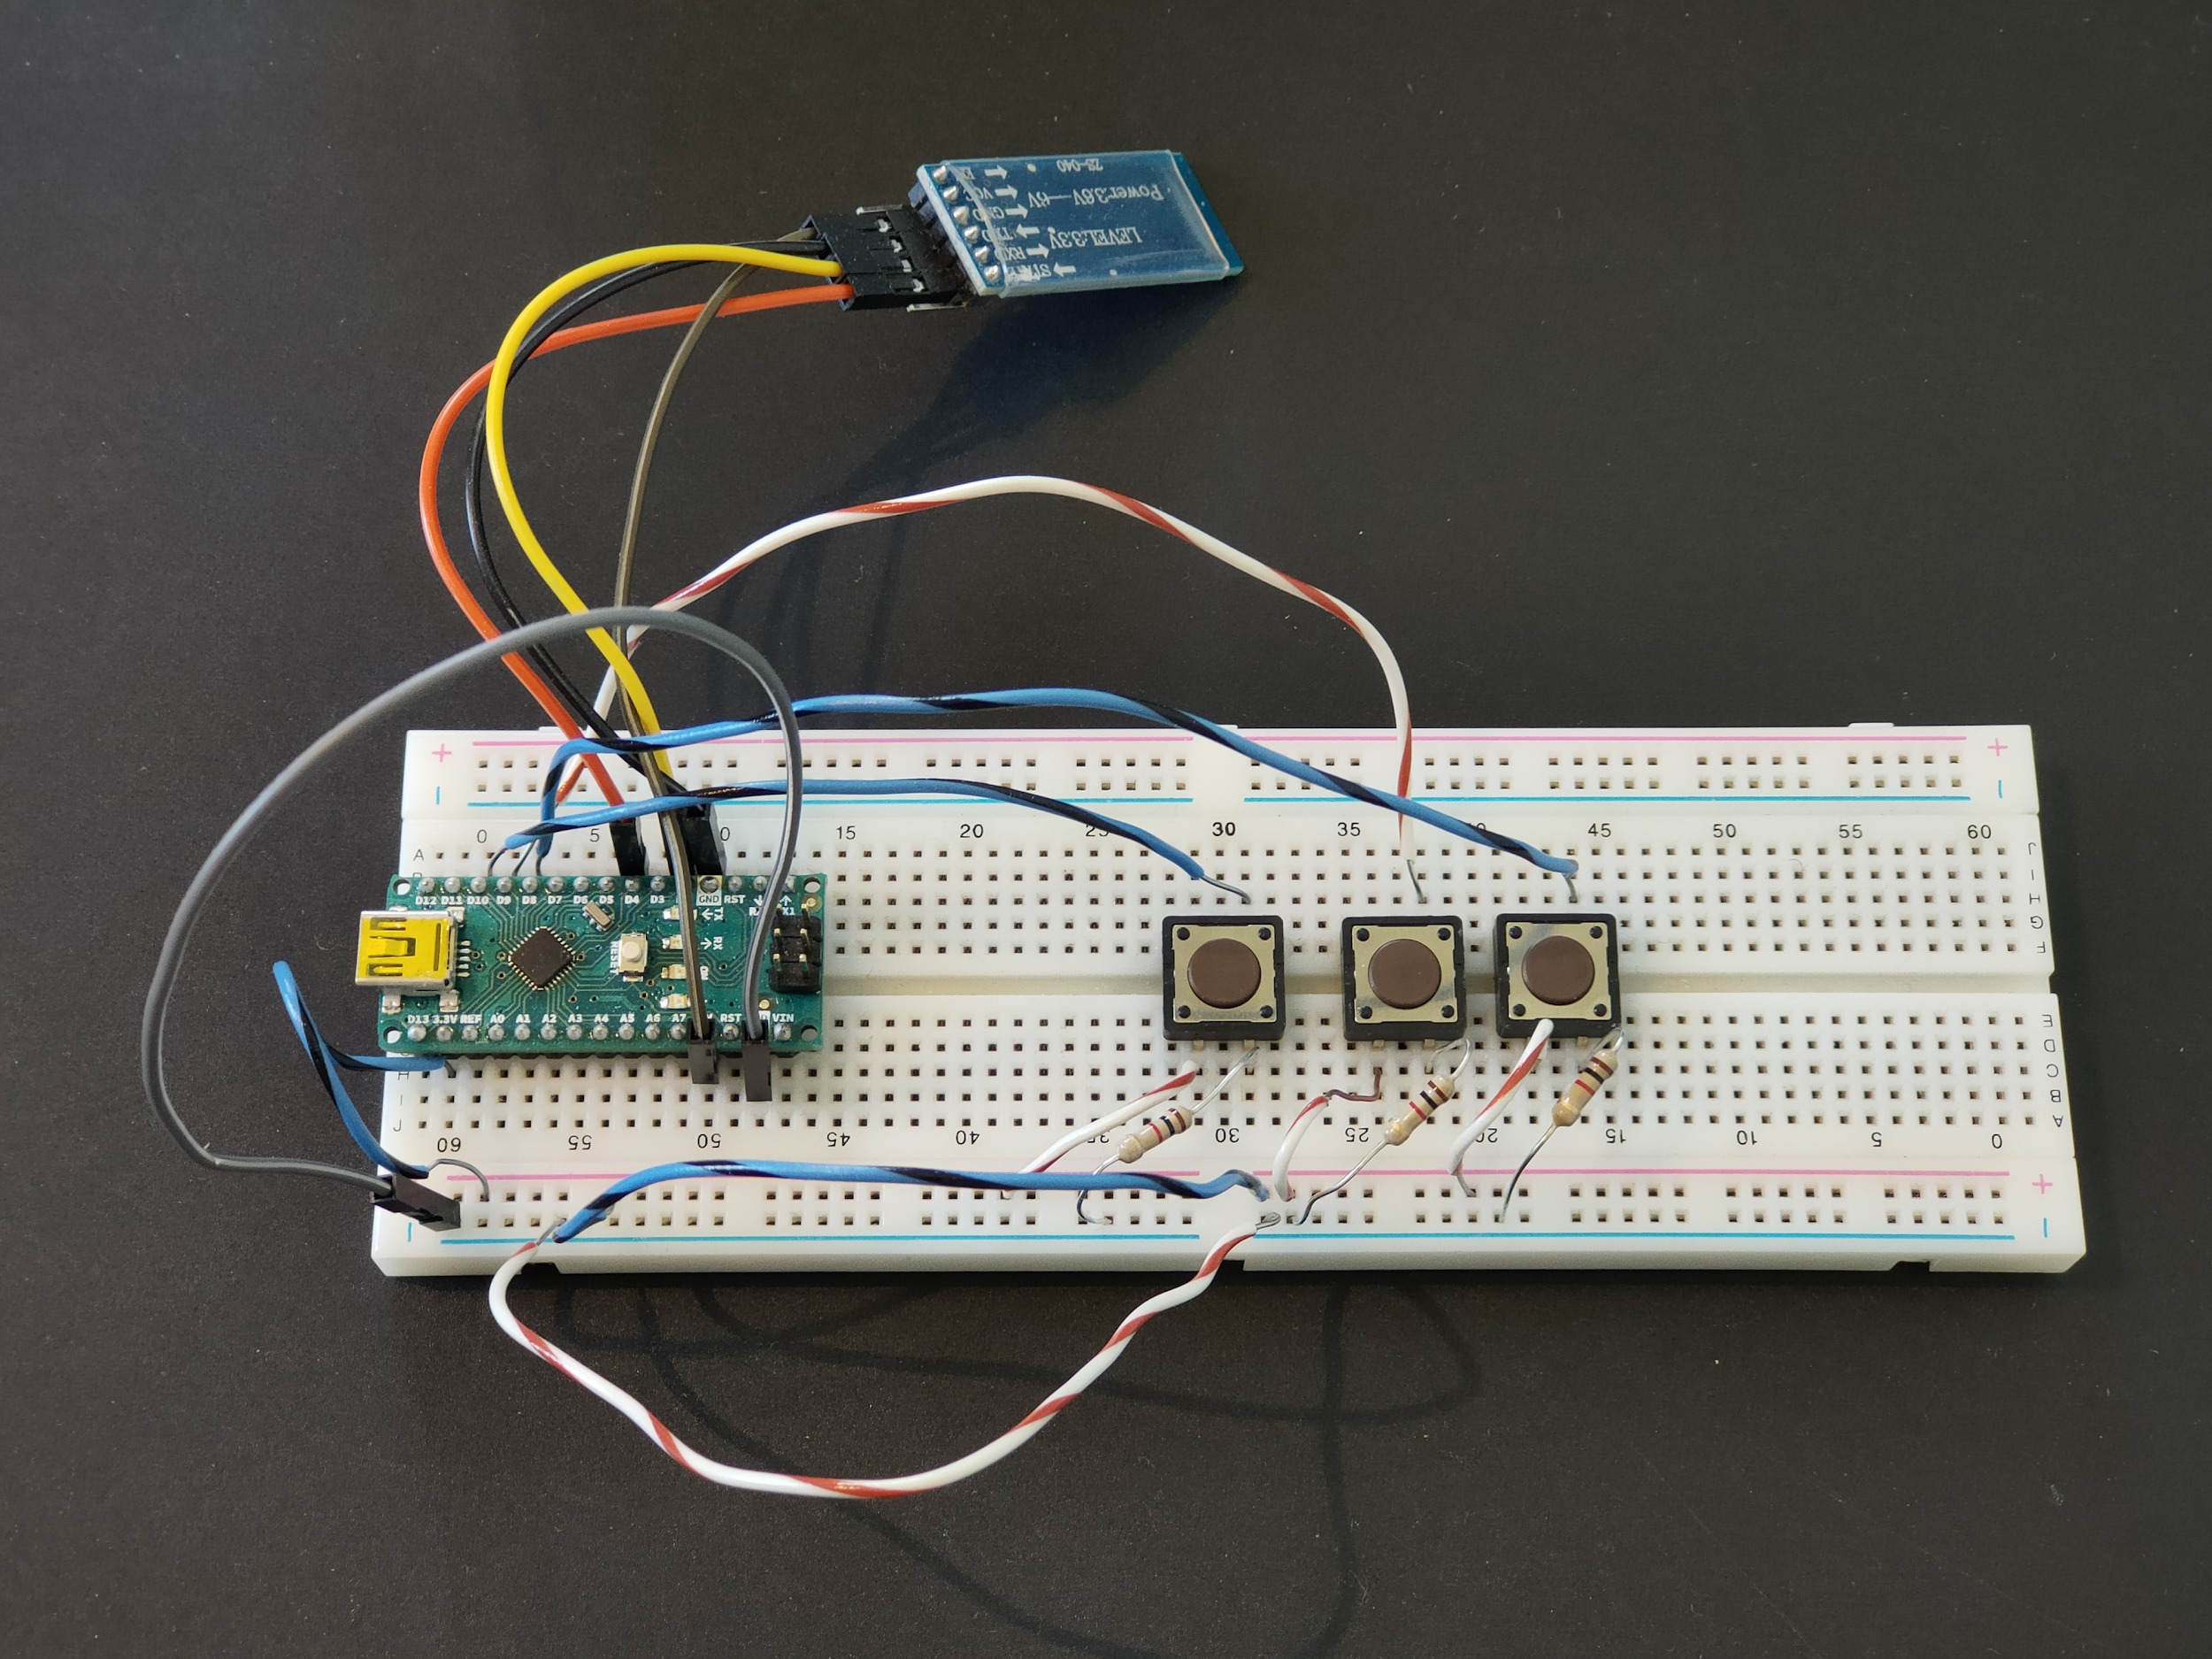
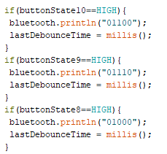
Testing connection
Dummy device
BT ZS040 = Similar to ESP32 BT chip
Notes:
Arnaud

Slide 10
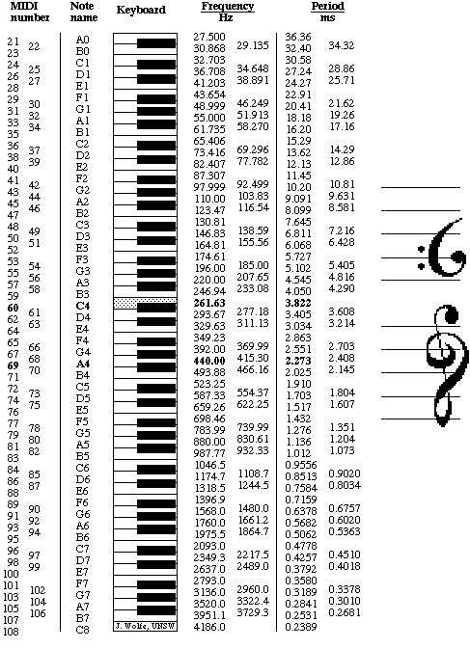
MIDI (Musical Instrument
Digital Interface)
Digital signal that tells the controller how to play a specific sound
Note
Channel (up to 16)
Velocity
Series of binary digits
Notes:
Arnaud
which note is pressed
the moment a note is pressed and released
the velocity (how hard it is pressed)
after-touch (when key pressure changes)
vibrato, and even;
pitch bend,
Layering

Slide 11
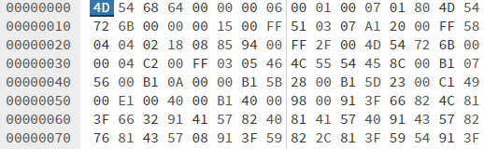
Working with Midi?
Hexadecimal mess
Completely incomprehensible
Notes:
Arnaud

Slide 12

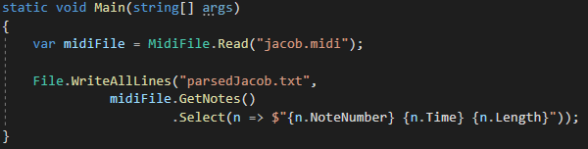
Make midi understandable
https://github.com/melanchall/drywetmidi
DryWet Midi Library
Parsing Midi Files
Notes:
Arnaud

Slide 13
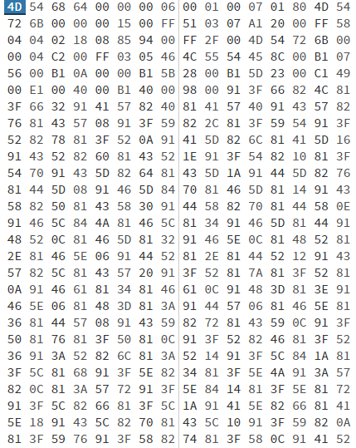
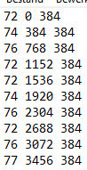
Parsing midi file
When played
Played note
How long
Notes:
Arnaud

Slide 14
Android application

Slide 15
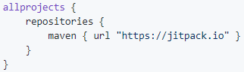
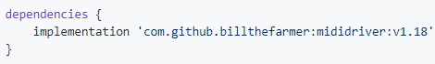
Midi controller
https://github.com/billthefarmer/mididriver#start-of-content
build.gradle(Project:)
build.gradle(Module:app)
Notes:
Stijn
billthefarmer.mididriver

Slide 16
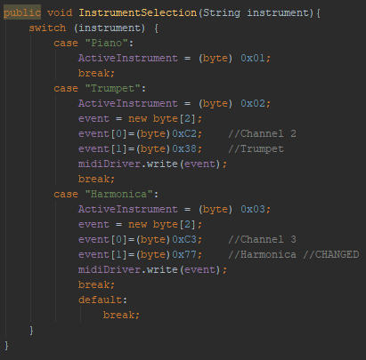
Change Instrument
ActiveInstrument = channel
event[0] : (byte) 192 + channel number
event[1] : (byte) number between 0-127
Notes:
Stijn
Change instrument = identify on which channel a particular instrument is played
Default: Piano on channel 1
First we write a byte to indicate on which channel we want to configure an instrument:
1100 0000 + channel number
After that we write a byte to indicate what instrument
Number between 0 and 127

Slide 17
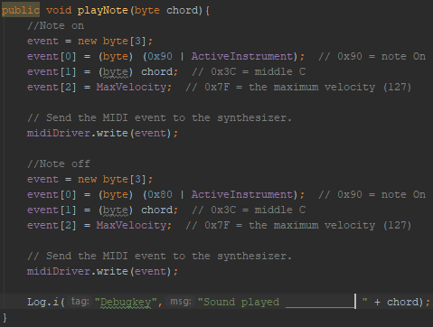
Play Note
Note On:
event[0]: (byte) 144 + channel number
event[1]: note to play
event[2]: velocity
Note Off:
event[0]: (byte) 128 + channel number
event[1]: note to play
event[2]: velocity
Notes:
Stijn
To play a note, 2 different signals are send, with only a small difference between them.
First: Note On signal
Snd: Note Off signal

Slide 18
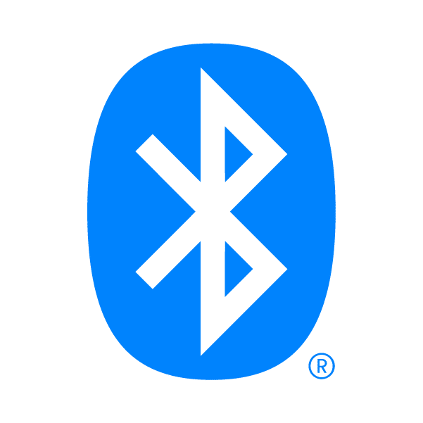
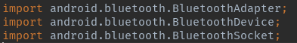
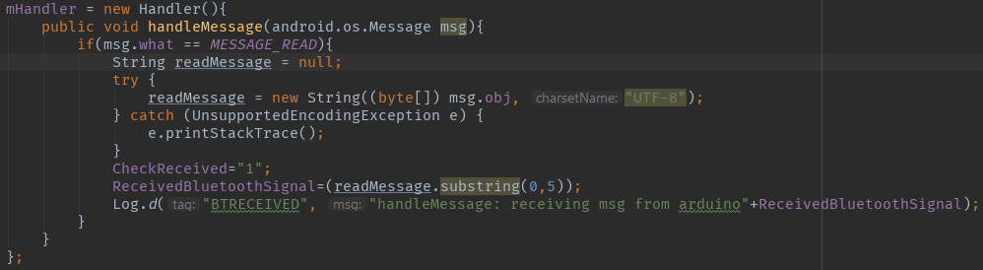
Connection Software <-> Hardware
https://developer.android.com/guide/topics/connectivity/bluetooth
Bluetooth (v 5.0)
Default Android Bluetooth Library
Bluetooth Handler checking for incoming signals
Notes:
Arnaud

Slide 19
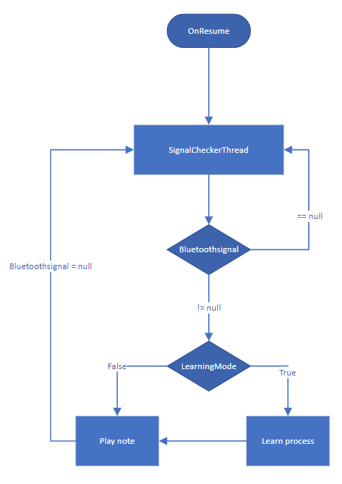
Application fundamentals
Wait on ReceivedBluetoothSignal
If one is received, execute according method on UI thread
ReceivedBluetoothSignal set to null
Repeat
Notes:
Stijn
In OnResume a Thread is started, the SignalCheckerThread.
It is an infinite loop that waits on a bluetooth signal. If it receives one, it executes the according method on the UI thread.
After this is executed, the bluetooth signal is set back to null and the loop starts again.

Slide 20
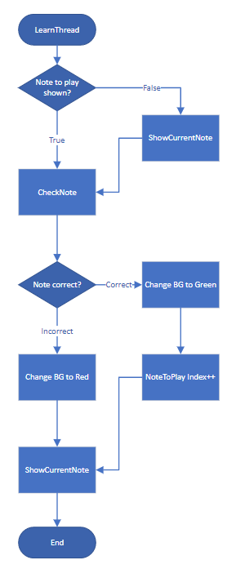
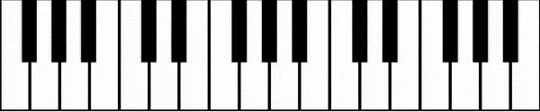
Learning Loop
Show note to be played (blue)
Check which note the received bluetoothsignal represents
Correct note: Tile lights up green, next note is shown
Incorrect note: Tile lights up red, same note is shown again
Process has to run on UI thread, otherwise the UI won’t update
Notes:
Stijn

Slide 21
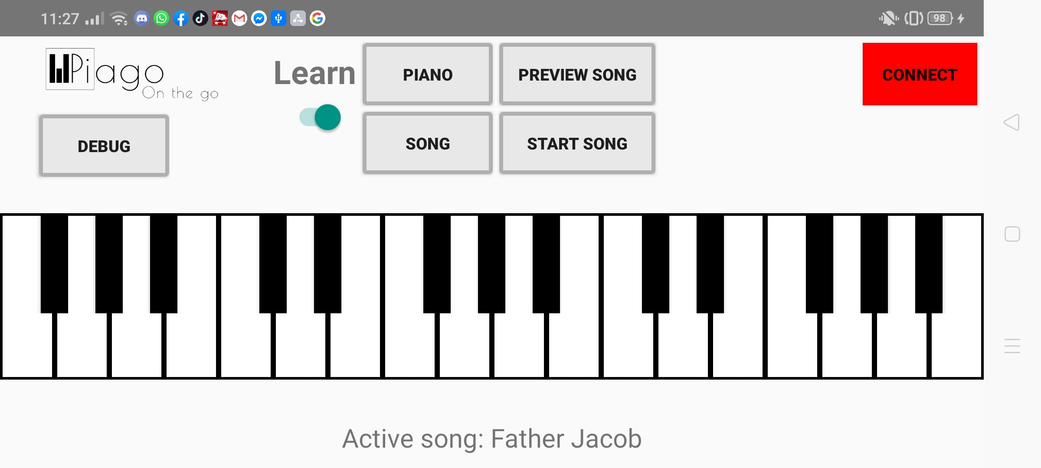
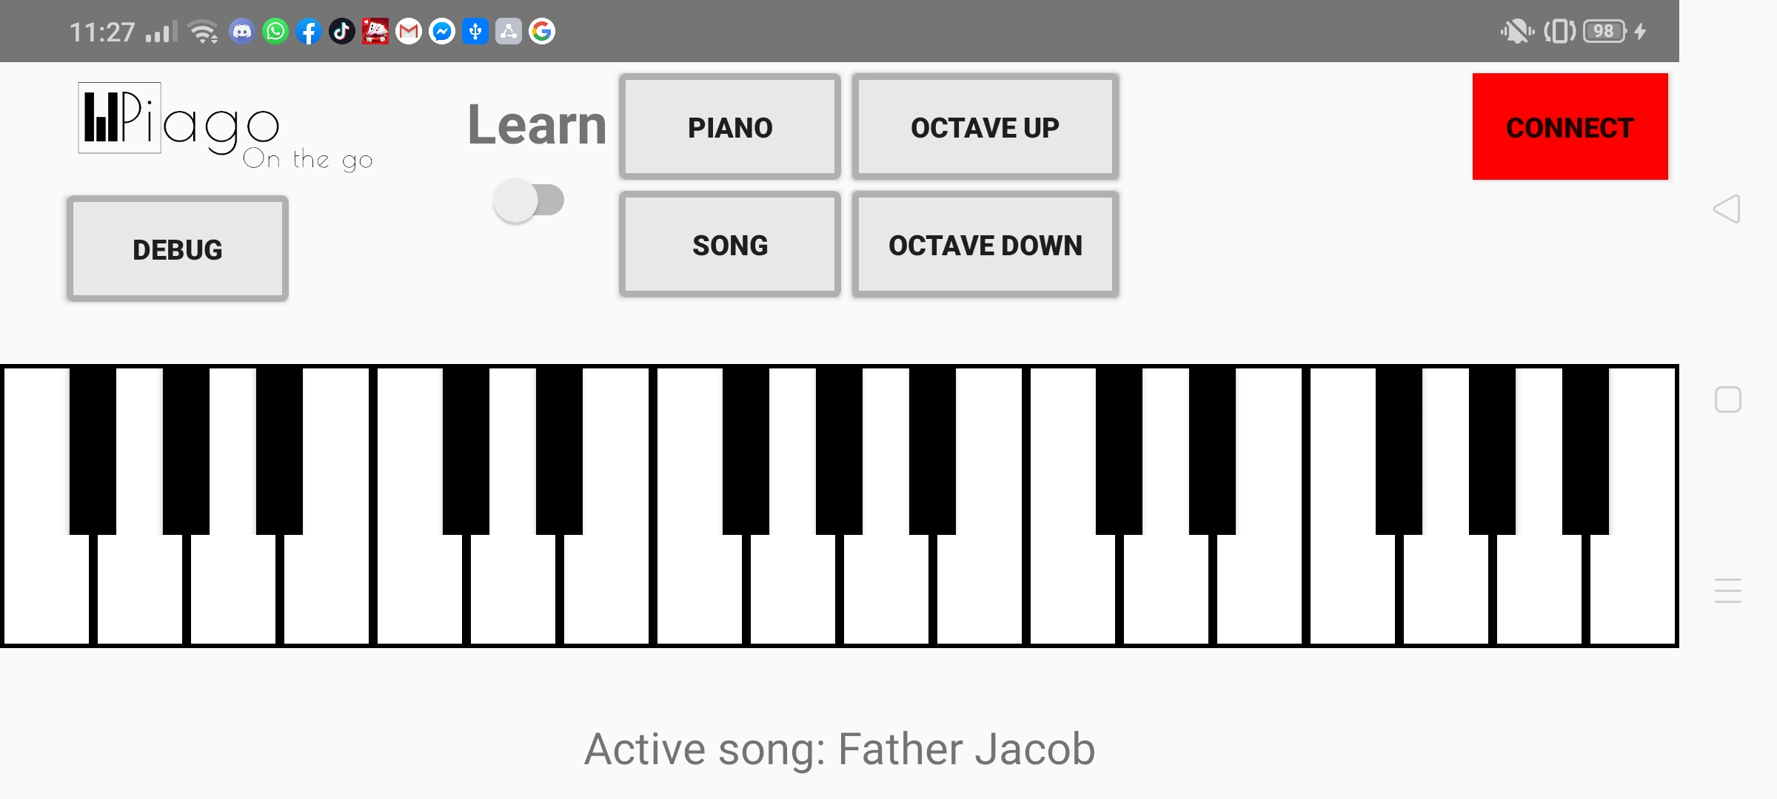
Lay-out
2 interfaces:
Learning mode
Regular mode
Octaves are set in stone for each different song
Debug key normally not there
Notes:
Arnaud

Slide 22
Desktop application
Notes:
Speaker Anton:

Slide 23
Midi in C#: MidiDotNet
https://github.com/jstnryan/midi-dot-net
Similar to Android MIDI-Controller
Can work with other input devices, such as electric keyboards
Notes:
Speaker: Anton

Slide 24
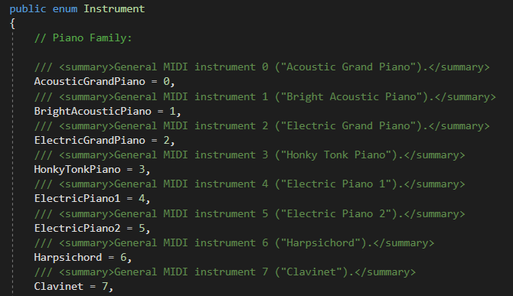
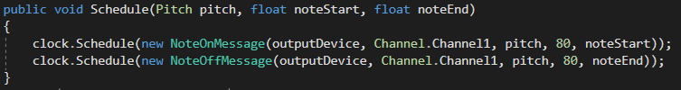
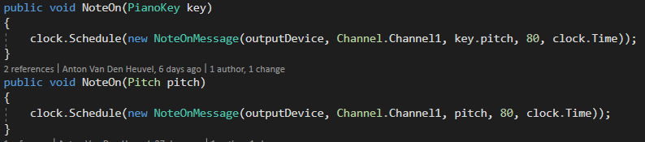
Instruments and notes
MidiDotNet translates byte-strings used in MIDI
Simpler NoteOn and NoteOff, instrument systems
Enums and floats
Works with a ‘clock’ = own thread
Notes can be played realtime
Makes note play without interruption
Notes can be scheduled to play after x-time
Clock can be adjusted to play songs faster or slower
Notes:
Speaker: Anton

Slide 25
Preview Song loop
When played
Played note
How long
Both systems can preview selected songs
New thread is started
Converted MIDI-file is read
NoteOn() is called, respective key is visualised
Thread sleeps until next note
NoteOff() for the first note, key gets cleared
NoteOn() for the next note, etc...
Notes:
Speaker: Anton
Both in C# and Android, we can also preview songs

Slide 26

C# Bluetooth
Why Bluetooth?
Easy to program?
User friendly
What we wanted
1 or 2 actions
Inside job
Notes:
Mathias +( Benoît ?)

Slide 27

C# Bluetooth
First iteration
Inside job
32FEET
No data traffic ?
No COM Port !
Second iteration
No inside job
Find mac address
WMI
Win32
Notes:
Mathias

Slide 28
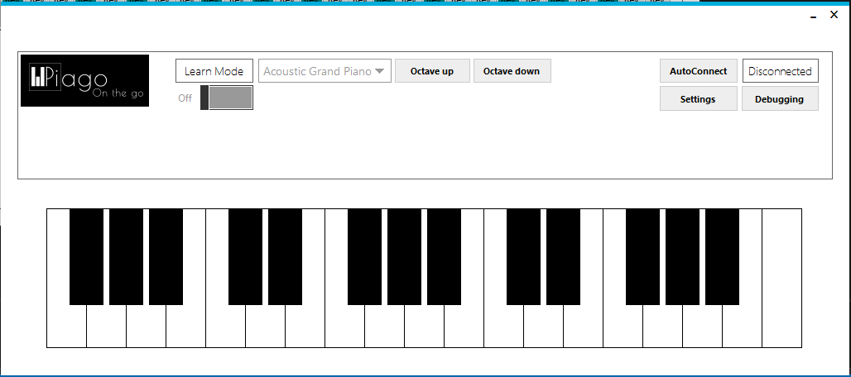
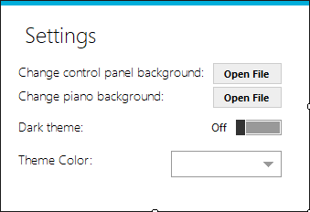
User Interface
Main Screen
Settings Screen
Notes:
Benoît+ intro

Slide 29
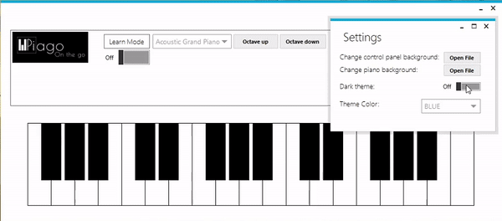
Settings Screen
Metro Framework
Common toolbox items
Easy to use
Customizability
Theme dependent
Notes:
Benoît

Slide 30

Settings Screen
Background chooser
OpenfileDialog
Application.OpenForms()
ChangeBackground(directory)
Notes:
Benoît

Slide 31
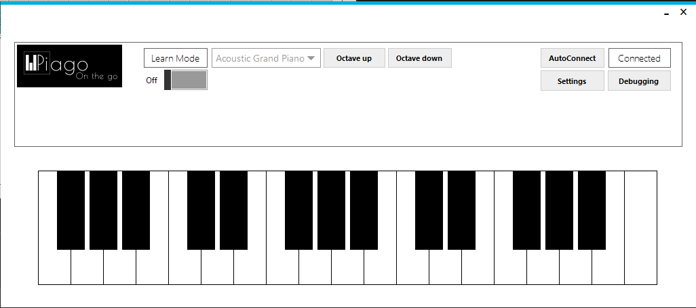
Main Screen
Piano
Drawing on Canvas
Abstract class Key with 5 child classes:
L-shaped Key
T-shaped Key
Reversed L-shaped Key
Black Key
White Key
32 Individually drawn keys
Easily scalable
Notes:
Benoît

Slide 32

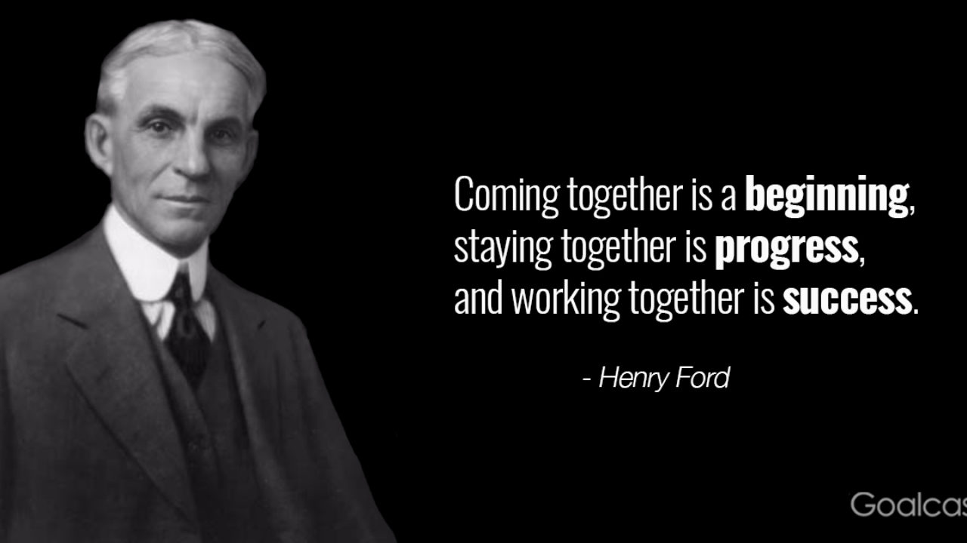
Reflection
Teamwork
Team spirit = Very high
Work was evenly distributed
Helping each other was necessary
Notes:
Speaker Mathias:
Work was evenly distributed: Everyone had their own tasks/responsibilities, if anyone needed help they only had to ask

Slide 33
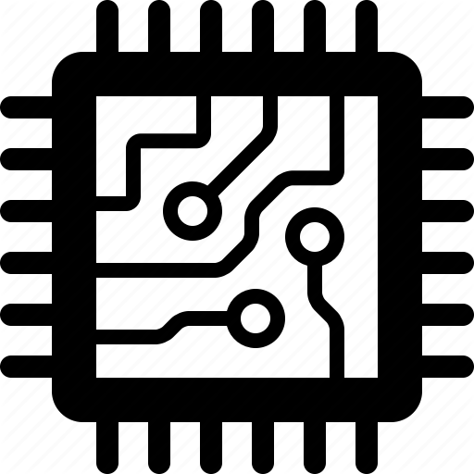
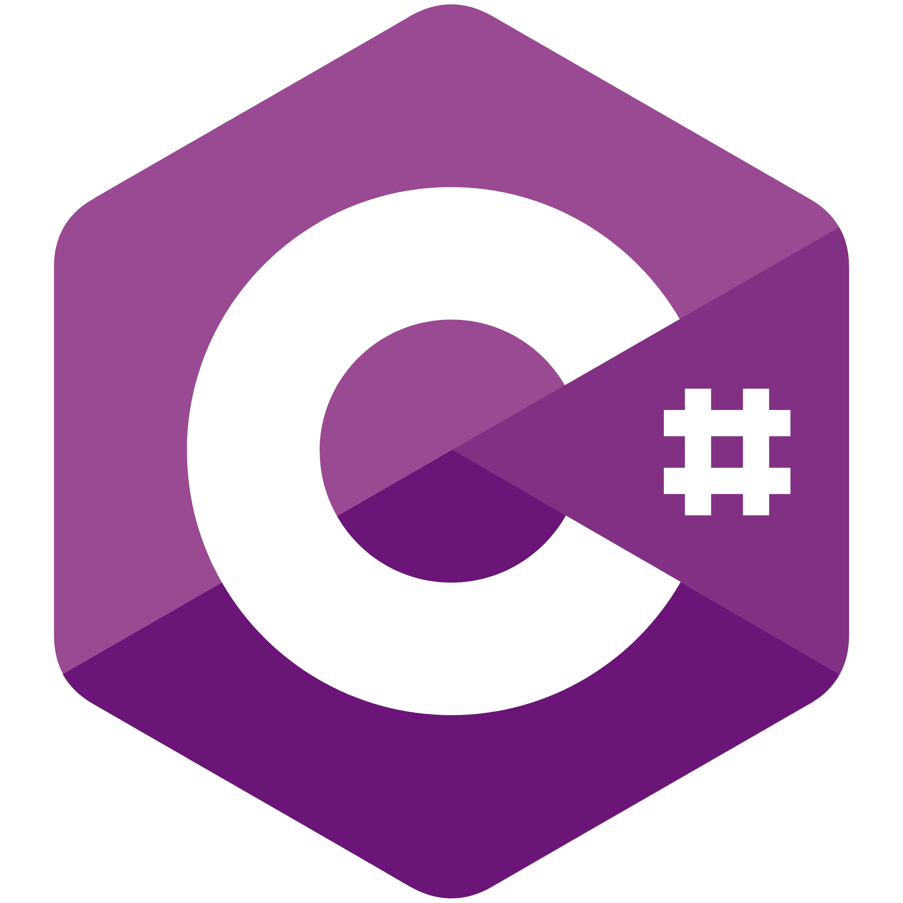
Reflection
Technical Aspects FIN
Better time management
Covid19
Motivation issues?
Faster decision on switching the sensor
Change happened just when school closed
Slow to design the backup
Notes:
Speaker: Janne
Not a fully functioning prototype:
More challenging than expected

Slide 34
Reflection
Technical Aspects BE
More challenging than expected
Achieved basic working application in the 2 ecosystems, but not more
Notes:
Arnaud
Not a fully functioning prototype:
More challenging than expected: Concepts and ideas who were thought simple in the beginning, became more complex once we started implementing them (MIDI, working with a lot of threads)
Achieved basic working application: The basic and fundamentals of the application are there, but we thought we would be able to accomplish a lot more at the start (No accounts, no music library, no point system, ...)

Slide 35
Reflection
Problems with MIDI
Original idea to put in any MIDI-song to learn in software was impossible:
Only 32 keys, normal keyboard has 88 keys!
Theoretically possible to force all notes onto 32 keys
But looks and sounds horrible
Chord-notes are not always played at the exact same time
Some MIDI songs recorded with electric instruments
Different timestamp for different notes, although same chord
Better to manually convert songs ourselves to fit system
Notes:
Speaker: Anton

Slide 36
Reflection
What could we have done better?
One application instead of 2
Started with wrong focus point
Slow start
At the end of each meeting, instantly planning the next meeting. Instead of “We’ll plan it later”
Notes:
Teemu: 1 application instead of 2: We wasted a lot of resources by creating 2 applications, actually doubling our work. If we focused our resources in 1 application, we would have been able to get more of the desired features done.
Wrong focus point: We started too late with enabling learning functionality. At the start of the project resources were spend on the development of the foundations of a account/login system, while this feature was far less important then the basic functionality of the application
Slow start: Our first few sprints we weren’t as productive as near the end. Progression was slow, only after the 2nd sprint we had a lot of work (technical)

Slide 37
Live demos - Videos
Android Demo
Desktop App Arduino Demo
Desktop App UI Demo
Android video (full functionality overview): https://youtu.be/EKwNqP9YrzE
Desktop App UI demo: https://www.youtube.com/watch?v=eOtJA8oeBvo&t=0s
Desktop App Arduino demo: https://www.youtube.com/watch?v=vOFhpjH7vc0&t=1s

